Slide 1

ST.ANN’S COLLEGE OF ENGINEERING & TECHNOLOGY:: CHIRALA DEPARTMENT OF ELECTRICAL & ELECTRONICS ENGINEERING
DESIGN AND COMPARISION OF ASSORTED FACTS CONTROLLERS
IN POWER SYSTEMS
Under the esteemed guidance of
Mr. B. Ashok Kumar M.E (Ph.D)
ASSISTANT PROFESSOR
Project Associates:
A.Gopi (11F05A0201)
Y.Anand Babu (10F01A02B9)
U.Durga Rao (10F01A02B0)
R.Yedukondalu Naik (11F05A0221)

Slide 2
ABSTRACT
This project deals with the simulation of various FACTS controllers using simulation program with Integrated circuits Emphasis (PSPICE). The Power electronic based FACTS devices can be added to power transmission and distribution systems at strategic locations to improve system performance. The FACTS controllers will control series impedance, shunt impedance, current, voltage and phase angle.

Slide 3
OBJECTIVE
In this project, simple circuit model of FC-TCR, TCSC, SSSC, STATCOM and UPFC systems are going to simulate through MATLAB.

Slide 4
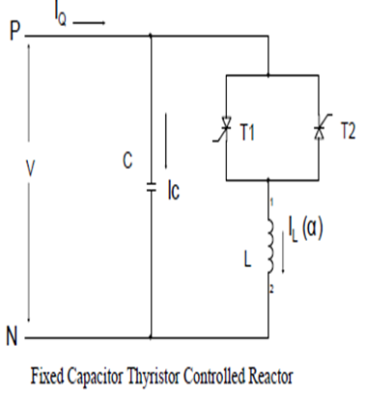
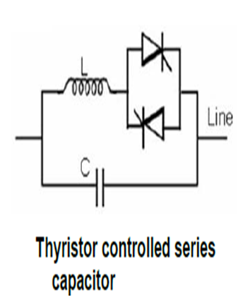
BLOCK DIAGRAMS

Slide 5
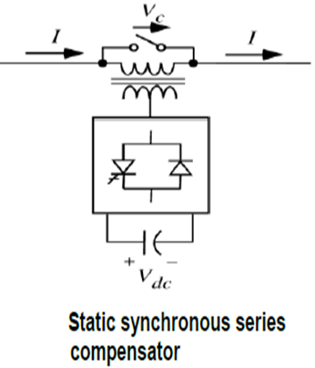
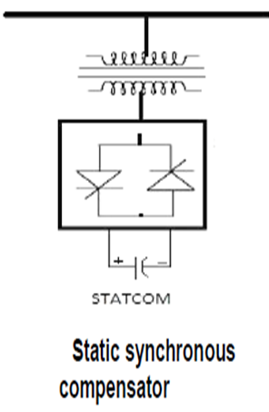
Contd...

Slide 6
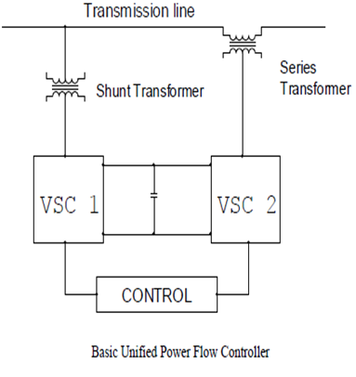
Contd...

Slide 7
IMPLEMENTING METHODOLOGY
In this project, simple circuit models of various FACTS Controllers are going to simulate through MATLAB.

Slide 8
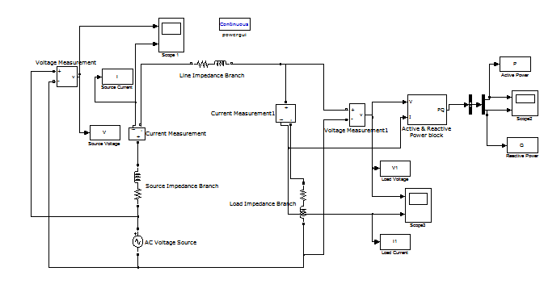
MATLAB CIRCUITS
BASIC TRANSMISSION LINE

Slide 9
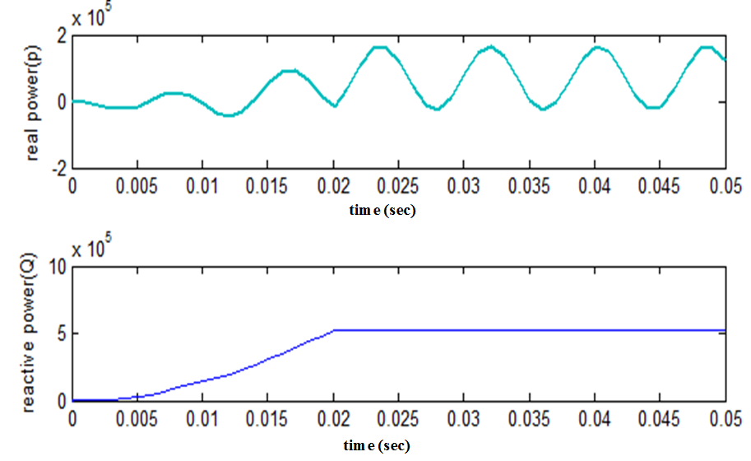
OUTPUT WAVE FORMS OF TRANSMISSION LINE

Slide 10
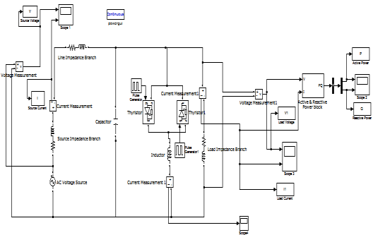
FIXED CAPACITOR THYRISTOR CONTROLLED REACTOR

Slide 11
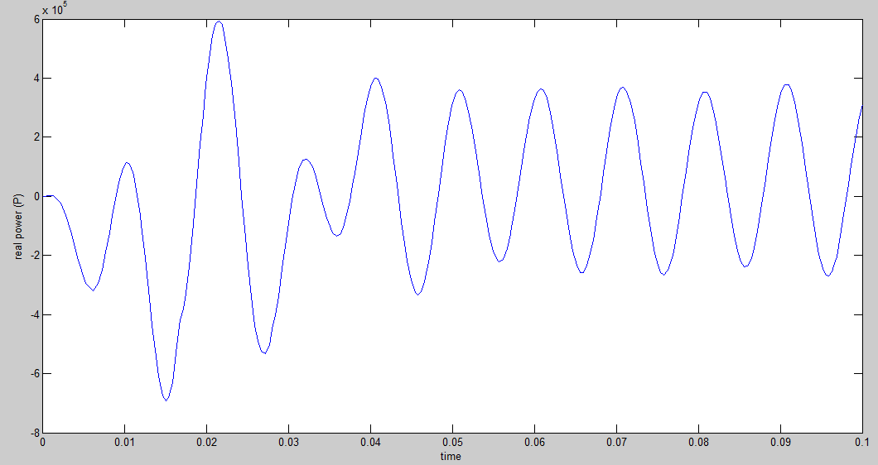
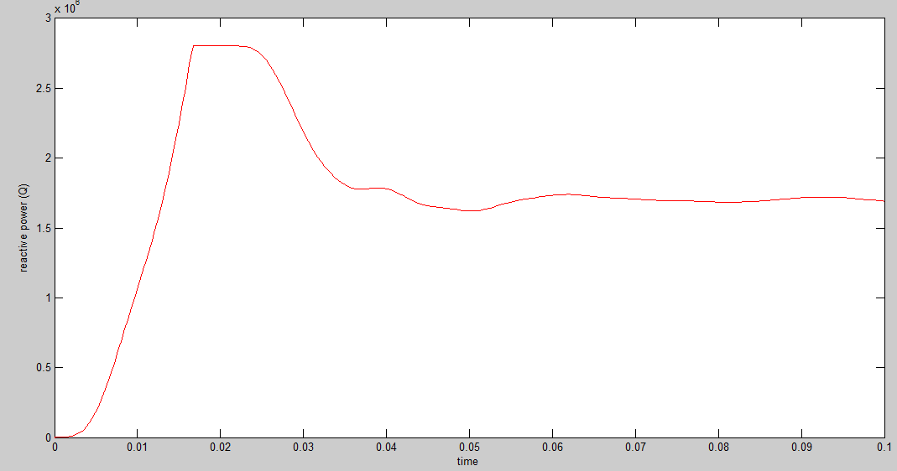
REAL POWER FLOW
REACTIVE POWER FLOW

Slide 12
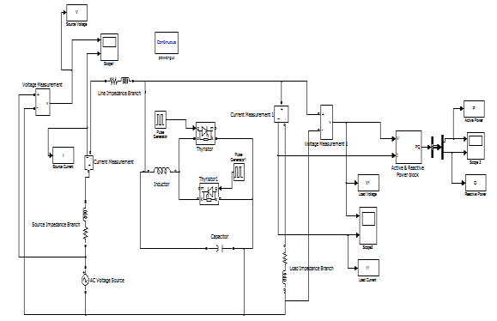
THYRISTOR CONTROLLED SERIES CAPACITOR (TCSC)

Slide 13
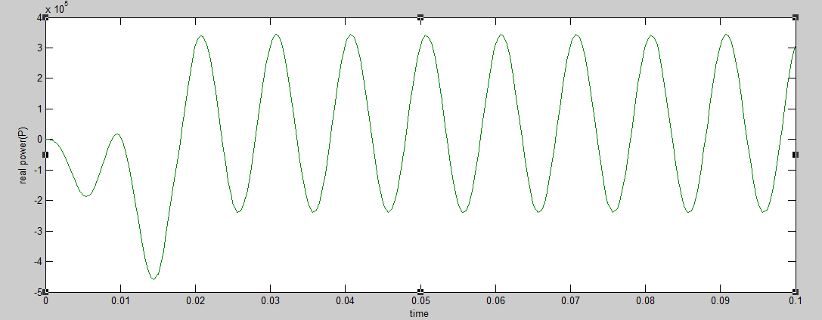
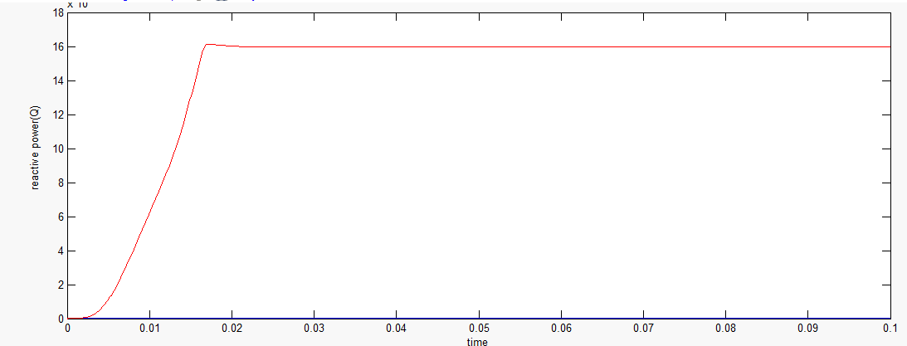
REAL POWER FLOW
REACTIVE POWER FLOW

Slide 14
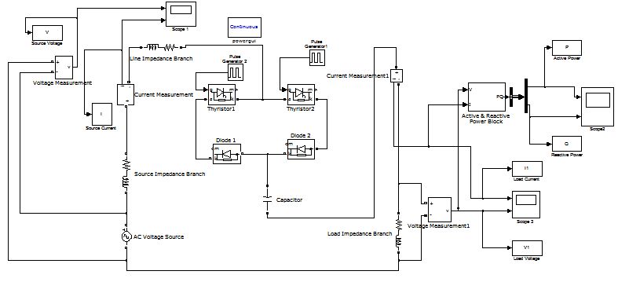
STATIC SYNCHRONOUS SERIES COMPENSATOR (SSSC)

Slide 15
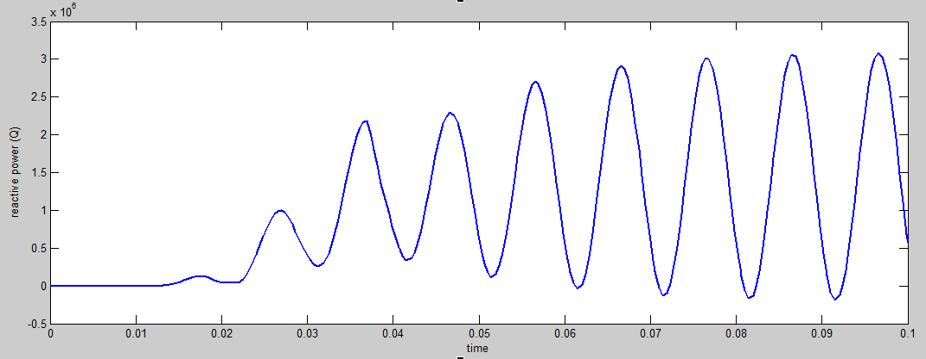
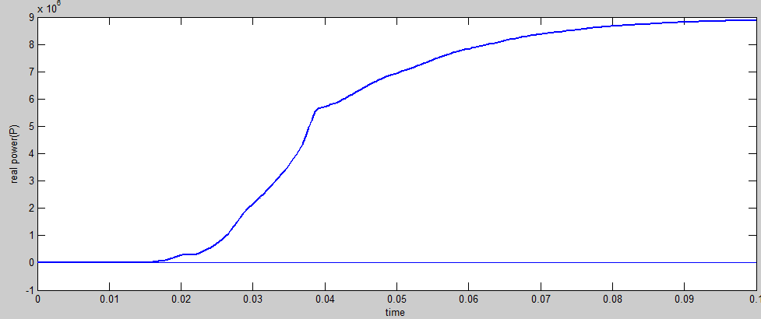
REAL POWER FLOW
REACTIVE POWER FLOW

Slide 16
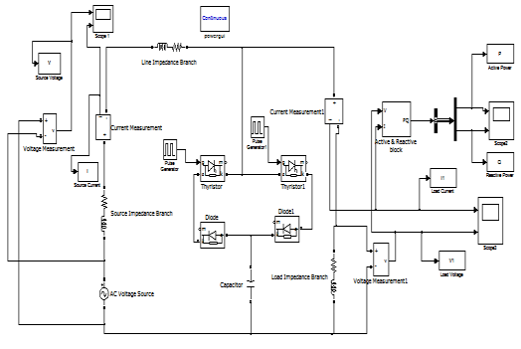
STATIC SYNCHRONOUS COMPENSATOR (STATCOM)

Slide 17
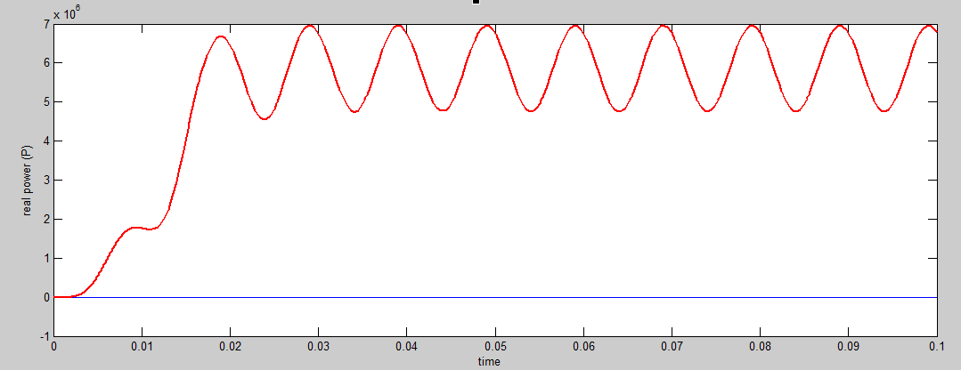
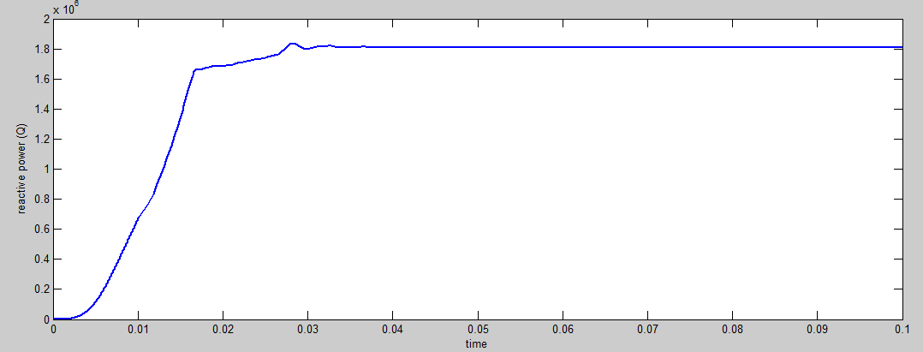
REAL POWER FLOW
REACTIVE POWER FLOW

Slide 18
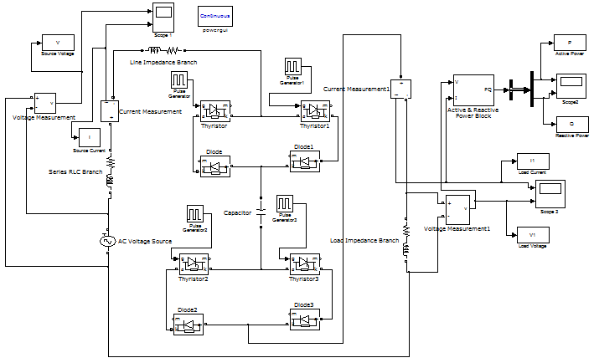
UNIFIED POWER FLOW CONTROLLER (UPFC)

Slide 19
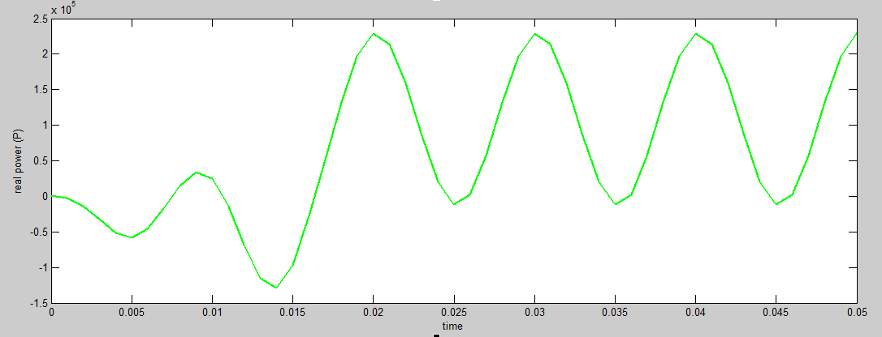
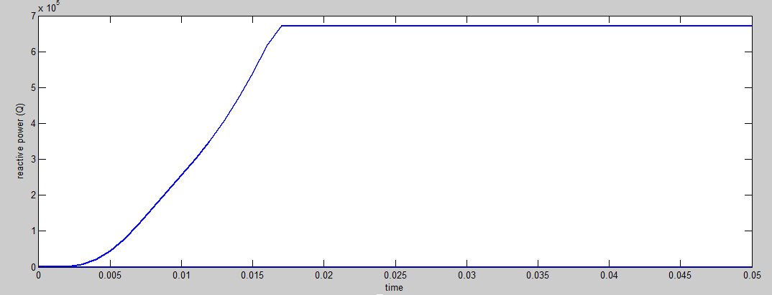
REAL POWER FLOW
REACTIVE POWER FLOW

Slide 20
CONCLUSION
The power electronic based FACTS devices can be added to power transmission and distribution systems at strategic locations to improve system performance.
Improvement of the Dynamic and transient Stability.
Power Quality Improvement.
Less Active and reactive Power loss.

Slide 21
REFERENCE PAPERS
[1] S. Sankar, S. Balaji, S.Arul, “ Simulation and Comparision of various FACTS devices in power systems”, International journal of engineering science and technologies, Vol.2(4), 2010
[2] Fugita & Watanaba(2008), “ Control and analysis of UPFC”, IEEE Transactions on Power electronics, Vol.14, No.6
[3] Gutierrtz, J,Montano, J.Castilla (2008), “Power Quality inprovement in reactive power control using FC-TCR circuits” IECON 08, Industrial Electronics Society, IEEE 2008
[4] Padiyar.K.R and uma Rao.K.(2008) “Modeling and Control of Unified Power Flow Controller for Transient Stability” Electrical Power & Energy Systems, pp.1-11

Slide 22
THANK ‘Q’

